Slide 1

Making Weather Forecasting Program
1307 Francis Yoon
1312 Edmond Jung
1406 Hun Shim

Slide 2
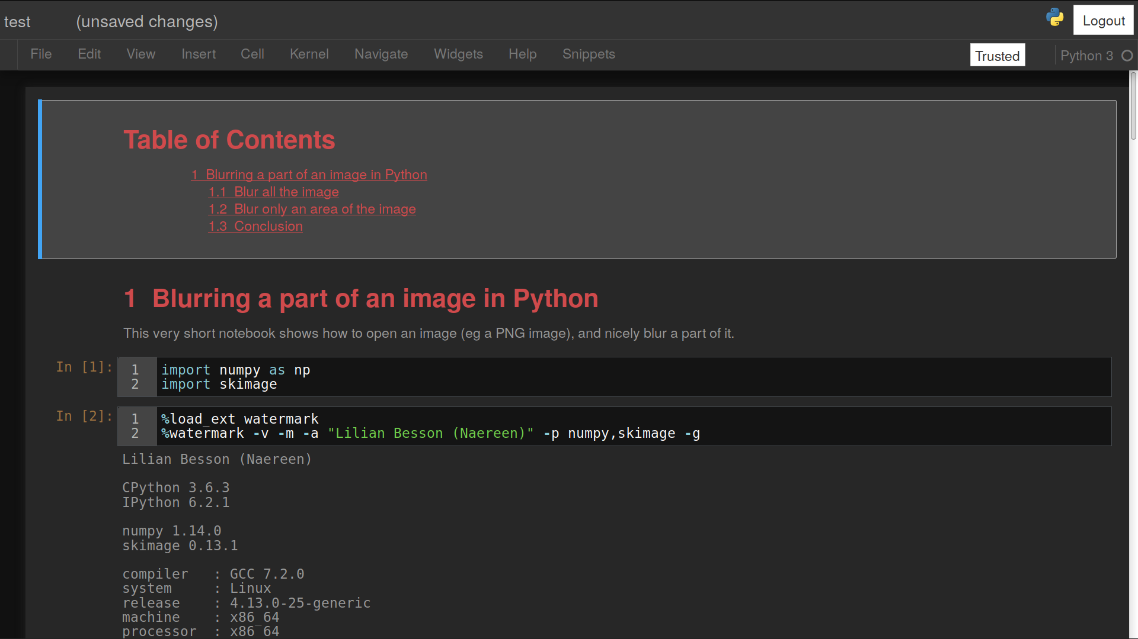
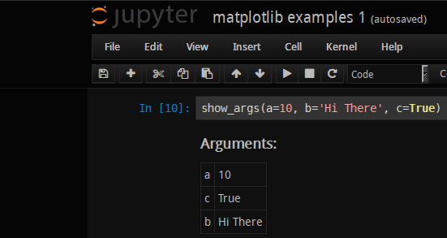
Index
In [1]: Motive
In [2]: Introduction
In [3]: Code
In [4]: Evaluation
In [5]: Reference

Slide 3
In [1]: print(“Motive”)
Out [1]:
Weather forecast was too inaccurate
To make more accurate, efficient model
Evaluate accuracy of model and decide its degree of completion

Slide 4
In [2]: print(“Introduction”)
Out [2]:
“The columns of Our dataset”
Date
Location
Temperature
Rainfall
Evaporation
Sunshine
Wind
Minimum, maximum, 9am, 3pm
Recorded for the day in mm
Recorded by Class A pan evaporation in mm
Recorded the number of hours of bright sunshine in the day
Recorded wind speed and direction

Slide 5
In [2]: print(“Introduction”)
Out [2]:
“The columns of Our dataset”
Humidity
Pressure
Cloud
RainToday
Fraction of sky obscured by cloud

Slide 6



In [2]: print(“Introduction”)
Out [2]:
“The columns of Our dataset”
By using temperature , wind direction,
wind speed , Humidity, Pressure , Cloud data
Predicting probability of rainfall

Slide 7
In [2]: print(“Introduction”)
Out [2]:
“The columns of Our dataset”
DATASET
In this process,
Artificial neural network system
is used
RESULT

Slide 8
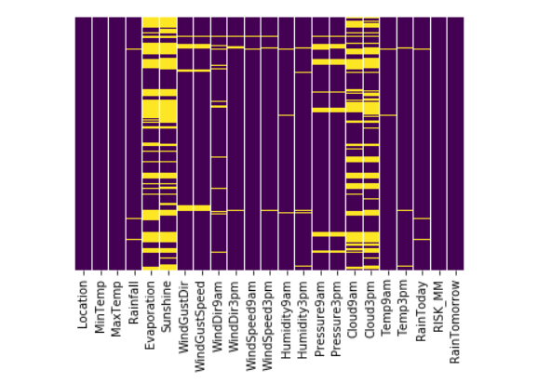
In [3]: print(“Code”)
Out [3]:
From the 142000 data of 49 cities, classified weather data
-According to heatmap, removed the NA data
→ 50000rows about 26cities left

Slide 9
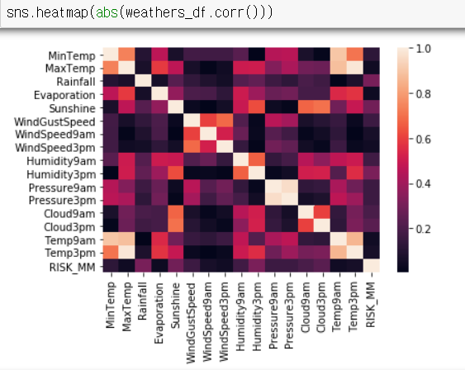
In [3]: print(“Code”)
Out [3]:
By using heatmap, analyzed which character was related with tomorrow’s rain
-chose the data
which has high correlationship

Slide 10
In [3]: print(“Code”)
Out [3]:
By using ‘get_dummies’, changed textual data to numeric data
Set train set and test set from the database and make logistic model
Repeat the model with various categories and find the best model

Slide 11
In [3]: print(“Code”)
Out [3]:
Tried with the logistic model,
but too much false prediction & low recall, precision value
 | 0 | 1
0 | TN True Negative | FP False positive
1 | FN False Negative | TP True Positive
TP
Precision =
TP+FP
TP
Recall =
TP+FN

Slide 12
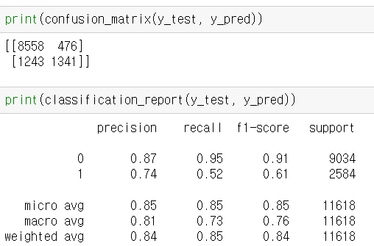
In [3]: print(“Code”)
Out [3]:
“Our logistic model’s result”

Slide 13
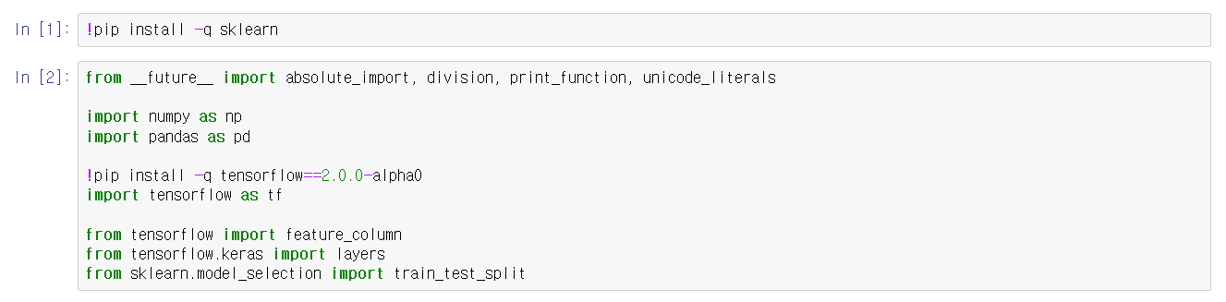
In [3]: print(“Code”)
Out [3]:
Imported tensorflow and other necessary libraries

Slide 14
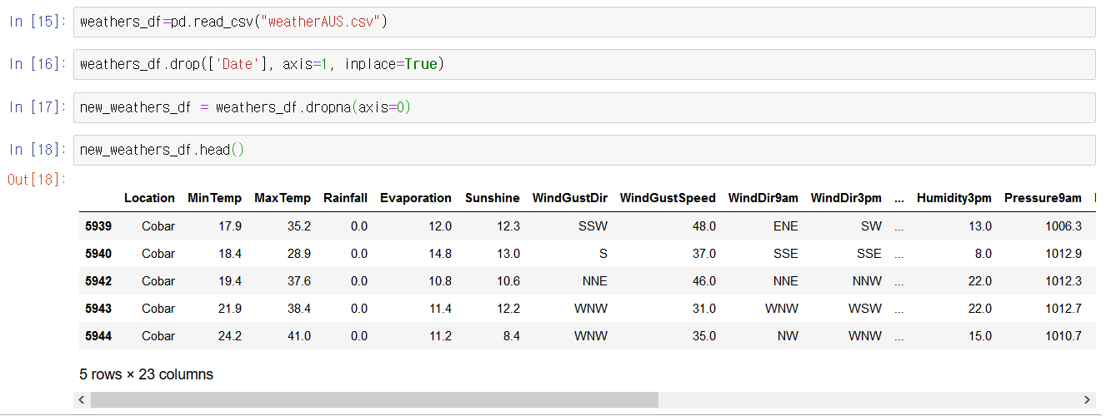
In [3]: print(“Code”)
Out [3]:
II. Read the Data file and removed rows which have ‘NA’

Slide 15
In [3]: print(“Code”)
Out [3]:
II. Read the Data file and removed rows which have ‘NA’

Slide 16
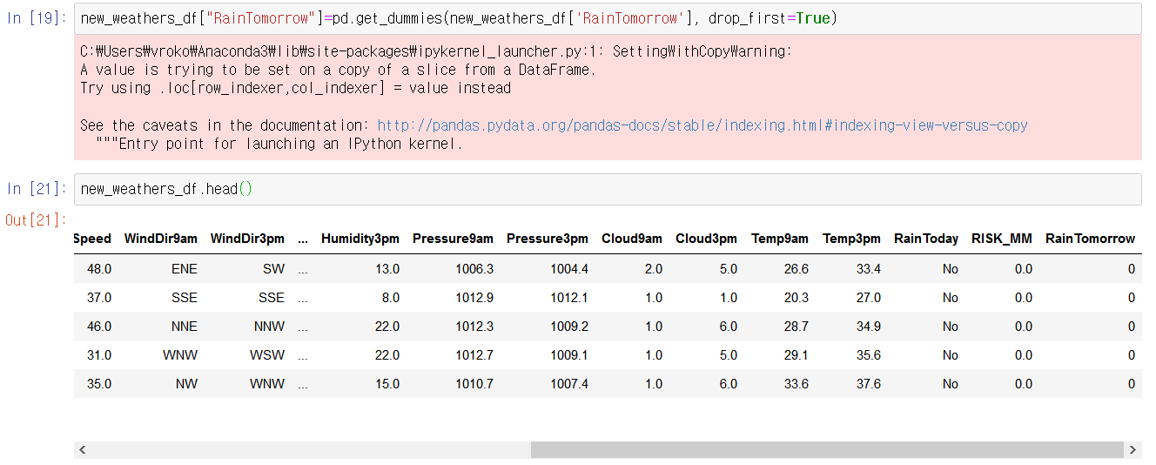
In [3]: print(“Code”)
Out [3]:
III. By using the function named ‘get_dummies’,
changed textual data in’Rain tomorrow’ to numeric data

Slide 17
In [3]: print(“Code”)
Out [3]:
III. By using the function named ‘get_dummies’,
changed textual data in’Rain tomorrow’ to numeric data

Slide 18
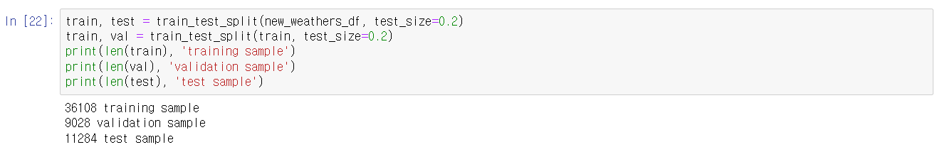
In [3]: print(“Code”)
Out [3]:
IV. Split the dataframe into train, validation, and test

Slide 19
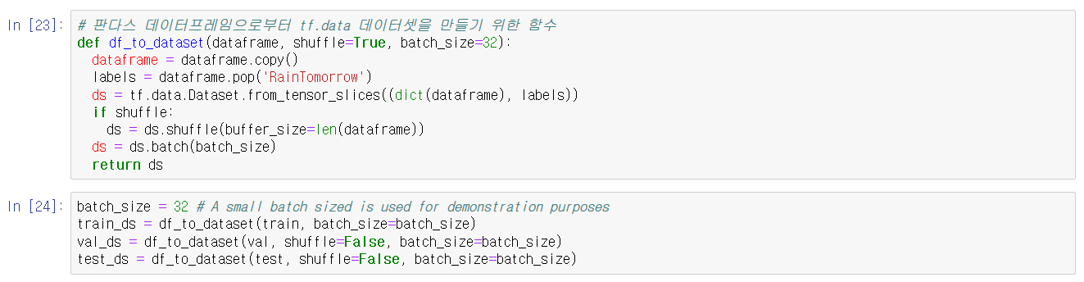
In [3]: print(“Code”)
Out [3]:
V. Created an input pipeline using tf.data

Slide 20
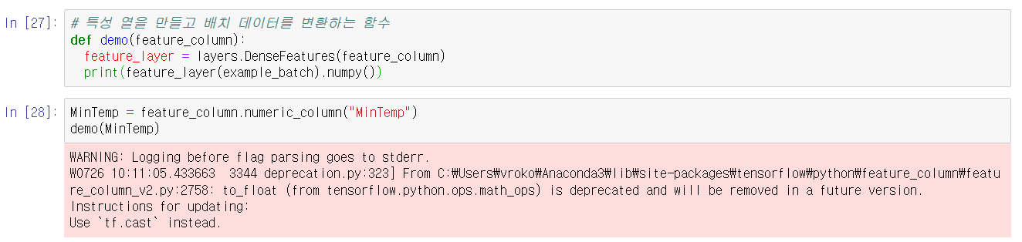
In [3]: print(“Code”)
Out [3]:
VI. Created Numeric and feature columns

Slide 21
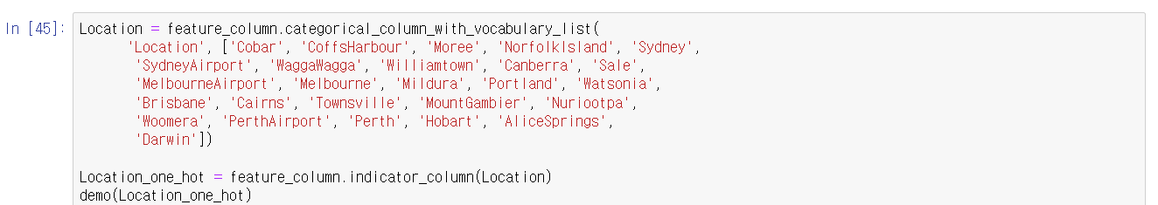
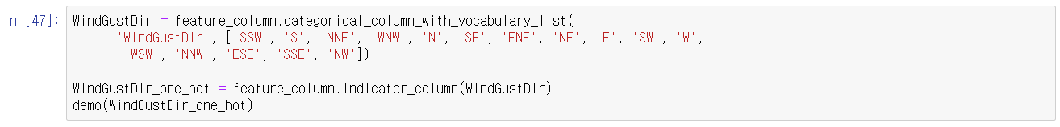
In [3]: print(“Code”)
Out [3]:
VI. Created Numeric and feature columns & Categorical columns

Slide 22
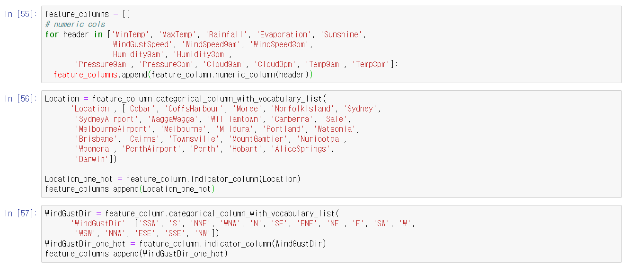
In [3]: print(“Code”)
Out [3]:
VII. Used numeric columns and categorical columns which we changed to train a model

Slide 23
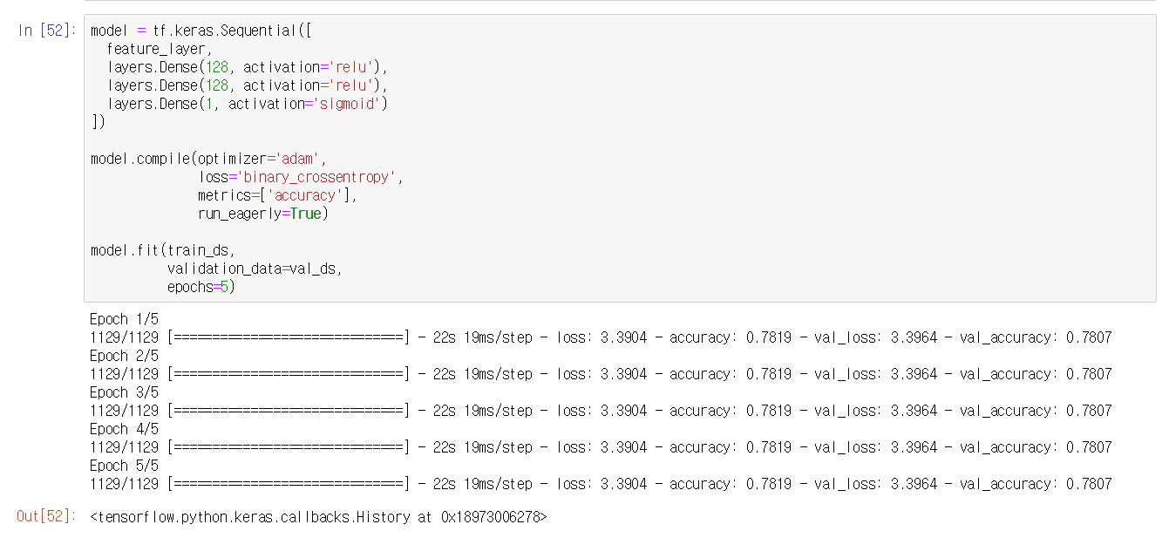
In [3]: print(“Code”)
Out [3]:
VIII. With data, created, compiled and trained the model

Slide 24
In [3]: print(“Code”)
Out [3]:
VIII. With data, created, compiled and trained the model

Slide 25
In [3]: print(“Code”)
Out [3]:
VIII. With data, created, compiled and trained the model

Slide 26
In [4]: print(“Evaluation”)
Out [4]:
Korean Meteorological Administration’s accuracy : 96%
Korean Meteorological Administration’s hit rate : 46%
Our forecasting system’s accuracy : 78%

Slide 27
In [4]: print(“Evaluation”)
Out [4]:
What We Can Do Further :
Build a Model to Predict the 'Amount of Rain Tomorrow'
Build a Model for other Countries
Improve Accuracy by Preventing Overfitting(Ex. Dropout)

Slide 28
In [5]: print(“Reference”)
Out [5]:
Beginner guide in Tensorflow
https://www.tensorflow.org/beta/tutorials/keras/feature_columns
‘Rainfall in Australia’ Dataset in Kaggle
https://www.kaggle.com/jsphyg/weather-dataset-rattle-package

Slide 29
In [6]: print(“Thank you”)
Thank you
Out [6]:
Shift
Enter

